Slide 1
Artificial Intelligence
A Modern Approach

Slide 2
Introduction to Artificial Intelligence
Course overview: Foundations of symbolic intelligent systems. Agents, search, problem solving, logic, representation, reasoning, symbolic programming, and robotics.
Prerequisites: Programming principles, discrete mathematics for computing, software design and software engineering concepts. Some knowledge of C/C++ for some programming assignments.

Slide 3
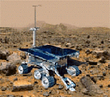

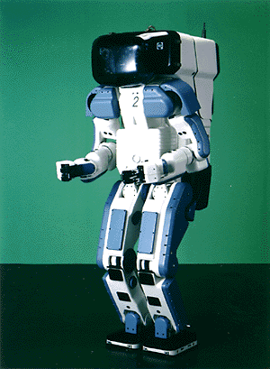

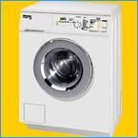
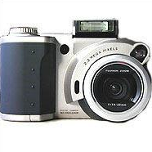

Why study AI?
Search engines
Science
Medicine/
Diagnosis
Labor
Appliances
What else?

Slide 4
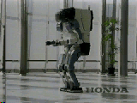
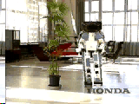
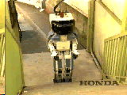
Honda Humanoid Robot
Walk
Turn
http://world.honda.com/ASIMO/
Stairs

Slide 5
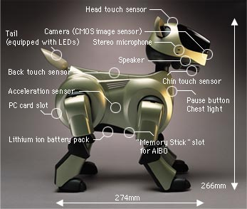
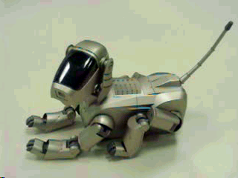
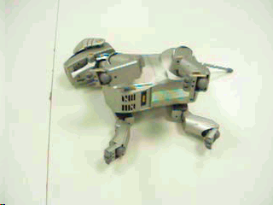
Sony AIBO

Slide 6
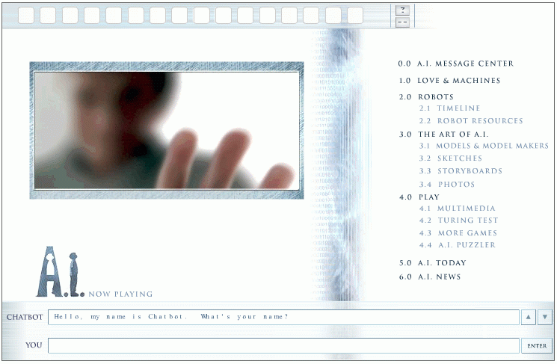
Natural Language Question Answering
http://aimovie.warnerbros.com
http://www.ai.mit.edu/projects/infolab/

Slide 7
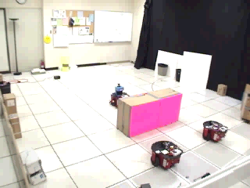
Robot Teams
USC robotics Lab

Slide 8
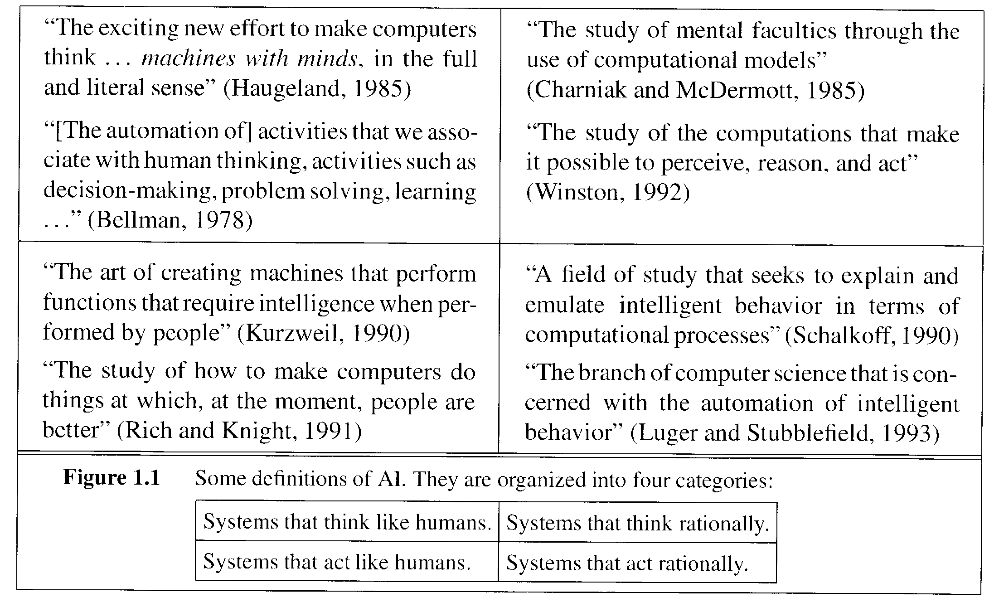
What is AI?

Slide 9
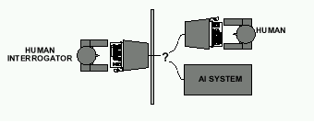
Acting Humanly: The Turing Test
Alan Turing's 1950 article Computing Machinery and Intelligence discussed conditions for considering a machine to be intelligent
  “Can machines think?” ←→ “Can machines behave intelligently?”
  The Turing test (The Imitation Game): Operational definition of intelligence.
Computer needs to posses:Natural language processing, Knowledge representation, Automated reasoning, and Machine learning
Are there any problems/limitations to the Turing Test?

Slide 10
What tasks require AI?
“AI is the science and engineering of making intelligent machines which can perform tasks that require intelligence when performed by humans …”
What tasks require AI?

Slide 11
What tasks require AI?
“AI is the science and engineering of making intelligent machines which can perform tasks that require intelligence when performed by humans …”
Tasks that require AI:
  Solving a differential equation
  Brain surgery
  Inventing stuff
  Playing Jeopardy
  Playing Wheel of Fortune
  What about walking?
  What about grabbing stuff?
  What about pulling your hand away from fire?
  What about watching TV?
  What about day dreaming?

Slide 12
Acting Humanly: The Full Turing Test
Alan Turing's 1950 article Computing Machinery and Intelligence discussed conditions for considering a machine to be intelligent
  “Can machines think?” ←→ “Can machines behave intelligently?”
  The Turing test (The Imitation Game): Operational definition of intelligence.
Computer needs to posses:Natural language processing, Knowledge representation, Automated reasoning, and Machine learning
Problem: 1) Turing test is not reproducible, constructive, and amenable to mathematic analysis. 2) What about physical interaction with interrogator and environment?
Total Turing Test: Requires physical interaction and needs perception and actuation.

Slide 13
What would a computer need to pass the Turing test?
Natural language processing: to communicate with examiner.
Knowledge representation: to store and retrieve information provided before or during interrogation.
Automated reasoning: to use the stored information to answer questions and to draw new conclusions.
Machine learning: to adapt to new circumstances and to detect and extrapolate patterns.
Vision (for Total Turing test): to recognize the examiner’s actions and various objects presented by the examiner.
Motor control (total test): to act upon objects as requested.
Other senses (total test): such as audition, smell, touch, etc.

Slide 14
Thinking Humanly: Cognitive Science
1960 “Cognitive Revolution”: information-processing psychology replaced behaviorism
Cognitive science brings together theories and experimental evidence to model internal activities of the brain
  What level of abstraction? “Knowledge” or “Circuits”?
  How to validate models?
    Predicting and testing behavior of human subjects (top-down)
    Direct identification from neurological data (bottom-up)
    Building computer/machine simulated models and reproduce results (simulation)

Slide 15
Thinking Rationally: Laws of Thought
Aristotle (~ 450 B.C.) attempted to codify “right thinking”
What are correct arguments/thought processes?
E.g., “Socrates is a man, all men are mortal; therefore Socrates is mortal”
Several Greek schools developed various forms of logic:
notation plus rules of derivation for thoughts.
Problems:
  Uncertainty: Not all facts are certain (e.g., the flight might be delayed).
  Resource limitations: There is a difference between solving a problem in principle and solving it in practice under various resource limitations such as time, computation, accuracy etc. (e.g., purchasing a car)

Slide 16
Acting Rationally: The Rational Agent
Rational behavior: Doing the right thing!
The right thing: That which is expected to maximize the expected return
Provides the most general view of AI because it includes:
  Correct inference (“Laws of thought”)
  Uncertainty handling
  Resource limitation considerations (e.g., reflex vs. deliberation)
  Cognitive skills (NLP, AR, knowledge representation, ML, etc.)
Advantages:
  More general
  Its goal of rationality is well defined

Slide 17
How to achieve AI?
How is AI research done?
AI research has both theoretical and experimental sides. The experimental side has both basic and applied aspects.
There are two main lines of research:
  One is biological, based on the idea that since humans are intelligent, AI should study humans and imitate their psychology or physiology.
  The other is phenomenal, based on studying and formalizing common sense facts about the world and the problems that the world presents to the achievement of goals.
The two approaches interact to some extent, and both should eventually succeed. It is a race, but both racers seem to be walking. [John McCarthy]

Slide 18
Branches of AI
Logical AI
Search
Natural language processing
pattern recognition
Knowledge representation
Inference From some facts, others can be inferred.
Automated reasoning
Learning from experience
Planning To generate a strategy for achieving some goal
Epistemology This is a study of the kinds of knowledge that are required for solving problems in the world.
Ontology Ontology is the study of the kinds of things that exist. In AI, the programs and sentences deal with various kinds of objects, and we study what these kinds are and what their basic properties are.
Genetic programming
Emotions???
…

Slide 19
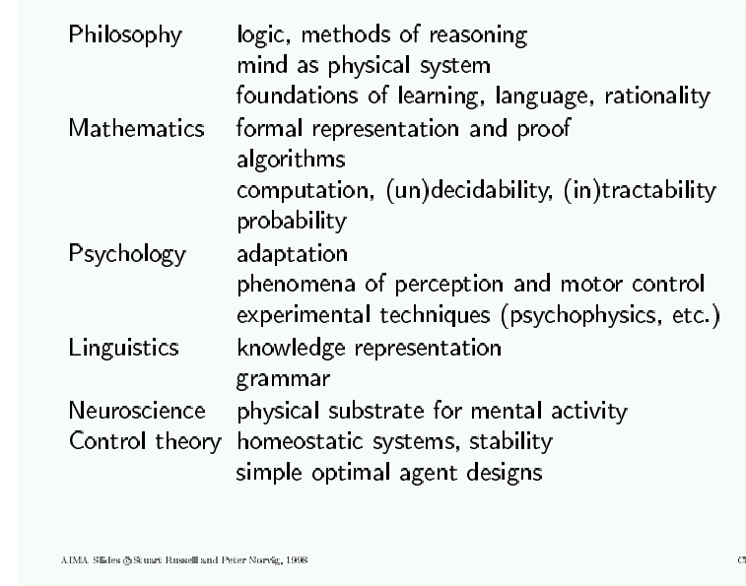
AI Prehistory

Slide 20
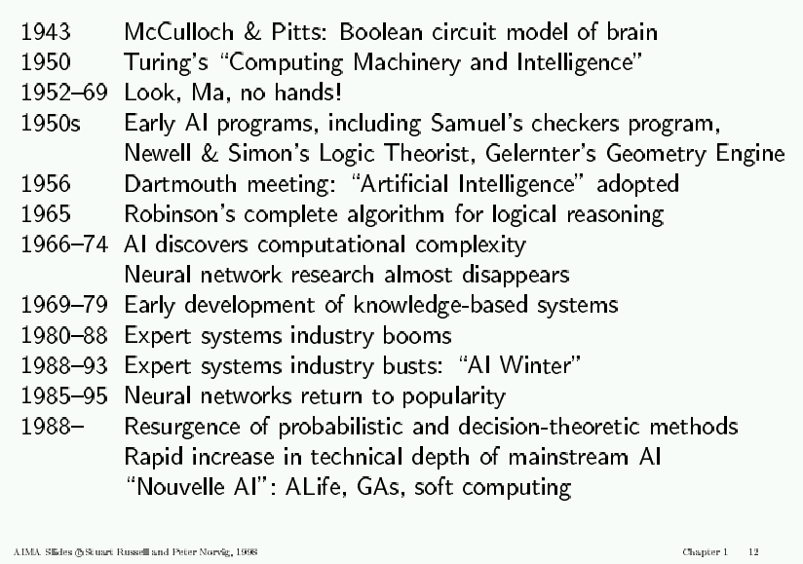
AI History

Slide 21
AI State of the art
Have the following been achieved by AI?
  World-class chess playing
  Playing table tennis
  Cross-country driving
  Solving mathematical problems
  Discover and prove mathematical theories
  Engage in a meaningful conversation
  Understand spoken language
  Observe and understand human emotions
  Express emotions
  …

Slide 22
Course Overview
General Introduction
01-Introduction. [AIMA Ch 1] Course Schedule. Home works, exams and grading. Course material. Why study AI? What is AI? The Turing test. Rationality. Branches of AI. Research disciplines connected to and at the foundation of AI. Brief history of AI. Challenges for the future. Overview of class syllabus.
02-Intelligent Agents. [AIMA Ch 2] What is an intelligent agent? Examples. Doing the right thing (rational action). Performance measure. Autonomy. Environment and agent design. Structure of agents. Agent types. Reflex agents. Reactive agents. Reflex agents with state. Goal-based agents. Utility-based agents. Mobile agents. Information agents.

Slide 23
Course Overview (cont.)
How can we solve complex problems?
03/04-Problem solving and search. [AIMA Ch 3] Example: measuring problem. Types of problems. More example problems. Basic idea behind search algorithms. Complexity. Combinatorial explosion and NP completeness. Polynomial hierarchy.
05-Uninformed search. [AIMA Ch 3] Depth-first. Breadth-first. Uniform-cost. Depth-limited. Iterative deepening. Examples. Properties.
06/07-Informed search. [AIMA Ch 4] Best-first. A* search. Heuristics. Hill climbing. Problem of local extrema. Simulated annealing.

Slide 24
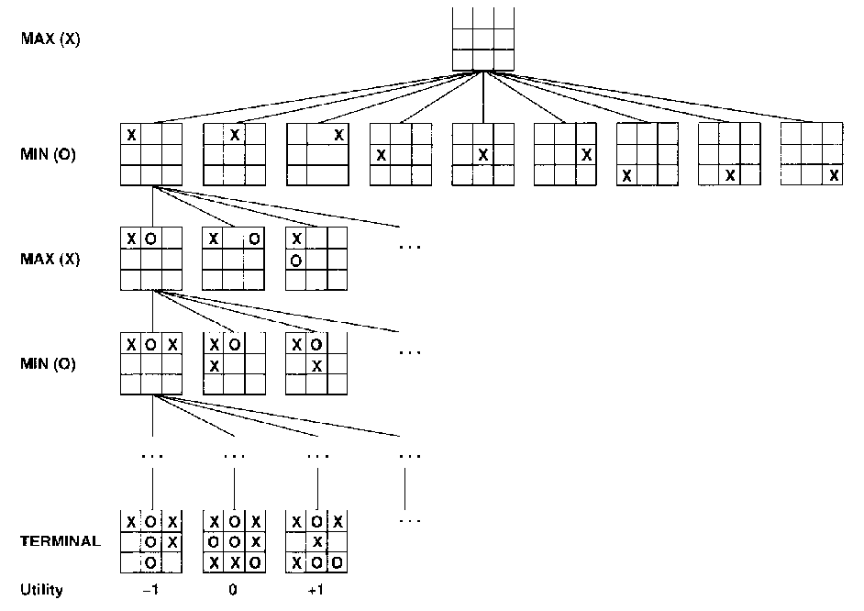
Course Overview (cont.)
Practical applications of search.
08/09-Game playing. [AIMA Ch 5] The minimax algorithm. Resource limitations. Aplha-beta pruning. Elements of
chance and non-
deterministic games.
tic-tac-toe

Slide 25
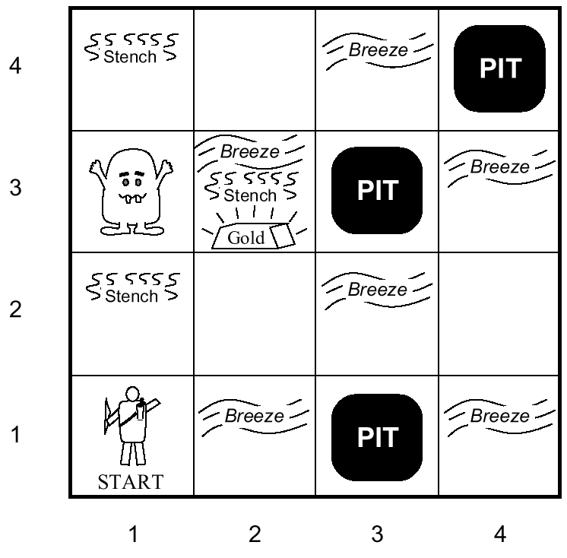
Course Overview (cont.)
10-Agents that reason logically 1. [AIMA Ch 6] Knowledge-based agents. Logic and representation. Propositional (boolean) logic.
11-Agents that reason logically 2. [AIMA Ch 6] Inference in propositional logic. Syntax. Semantics. Examples.
Towards intelligent agents
wumpus world

Slide 26
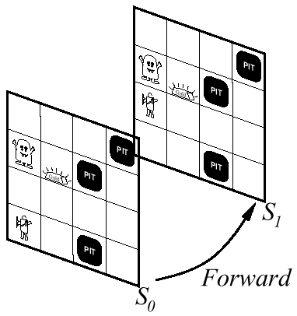
Course Overview (cont.)
Building knowledge-based agents: 1st Order Logic
12-First-order logic 1. [AIMA Ch 7] Syntax. Semantics. Atomic sentences. Complex sentences. Quantifiers. Examples. FOL knowledge base. Situation calculus.
13-First-order logic 2.
[AIMA Ch 7] Describing actions.
Planning. Action sequences.

Slide 27
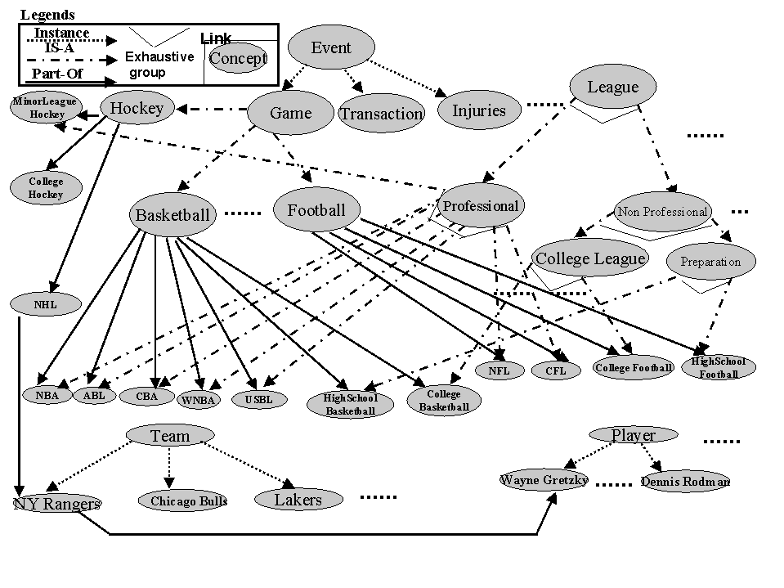
Course Overview (cont.)
Representing and Organizing Knowledge
14/15-Building a knowledge base. [AIMA Ch 8] Knowledge bases. Vocabulary and rules. Ontologies. Organizing knowledge.
An ontology
for the sports
domain
Kahn & Mcleod, 2000

Slide 28
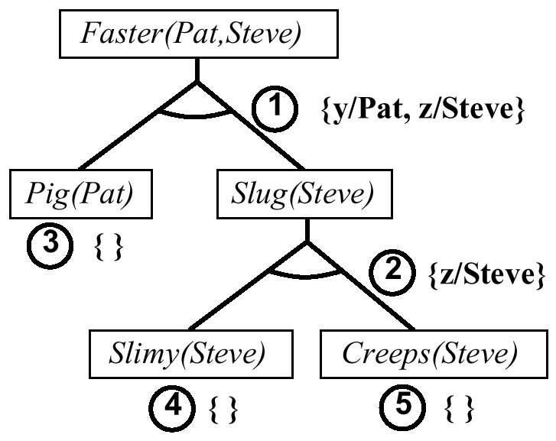
Course Overview (cont.)
Reasoning Logically
16/17/18-Inference in first-order logic. [AIMA Ch 9] Proofs. Unification. Generalized modus ponens. Forward and backward chaining.
Example of
backward chaining

Slide 29
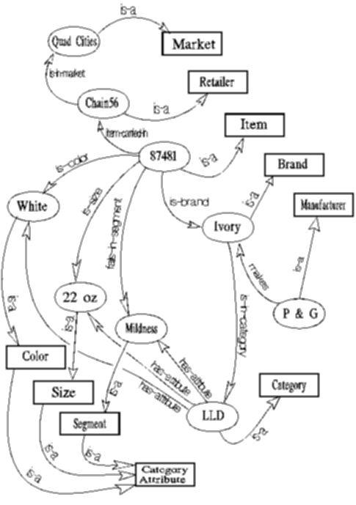
Course Overview (cont.)
Examples of Logical Reasoning Systems
19-Logical reasoning systems.
[AIMA Ch 10] Indexing, retrieval
and unification. The Prolog language.
Theorem provers. Frame systems
and semantic networks.
Semantic network
used in an insight
generator (Duke
university)

Slide 30
Course Overview (cont.)
Logical Reasoning in the Presence of Uncertainty
20/21-Fuzzy logic.
Introduction to
fuzzy logic. Linguistic
Hedges. Fuzzy inference.
Examples.
Center of gravity
Center of largest area

Slide 31
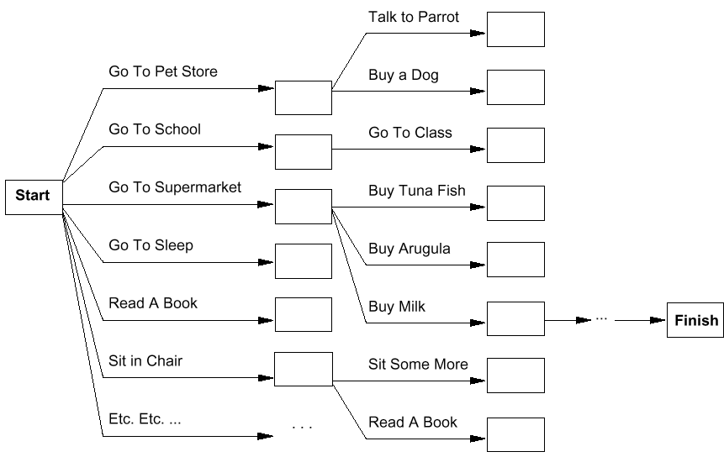
Course Overview (cont.)
Systems that can Plan Future Behavior
22/23-Planning. [AIMA Ch 11] Definition and goals. Basic representations for planning. Situation space and plan space. Examples.

Slide 32
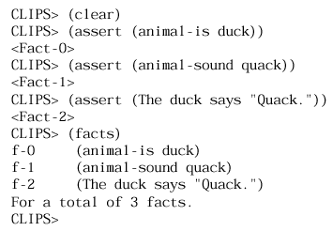
Course Overview (cont.)
Expert Systems
24-Expert systems 1. What are expert systems? Applications. Pitfalls and difficulties. Rule-based systems. Comparison to traditional programs. Building expert systems. Production rules. Antecedent matching. Execution. Control mechanisms.
25-Expert systems 2.
Overview of modern rule-based
expert systems. Introduction to
CLIPS (C Language Integrated
Production System). Rules.
Wildcards. Pattern matching.
Pattern network. Join network.
CLIPS expert system shell

Slide 33
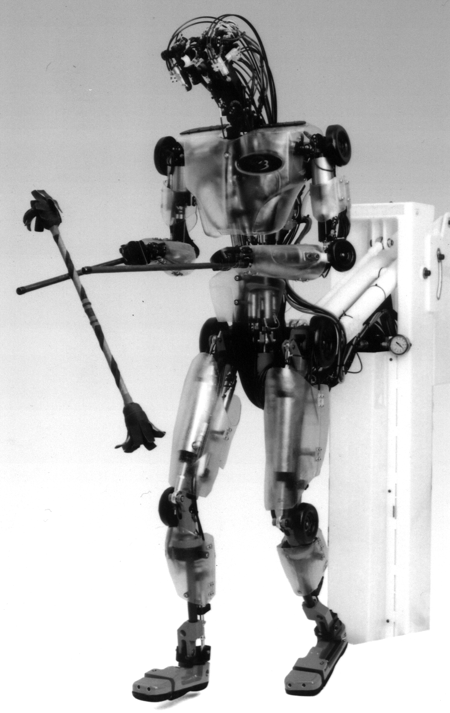
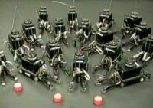
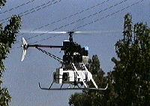
Course Overview (cont.)
What challenges remain?
26/27-Towards intelligent machines. [AIMA Ch 25] The challenge of robots: with what we have learned, what hard problems remain to be solved? Different types of robots. Tasks that robots are for. Parts of robots. Architectures. Configuration spaces. Navigation and motion planning. Towards highly-capable robots.
28-Overview and summary. [all of the above] What have we learned. Where do we go from here?

Slide 34
A driving example: Beobots
Goal: build robots that can operate in unconstrained environments and that can solve a wide variety of tasks.

Slide 35
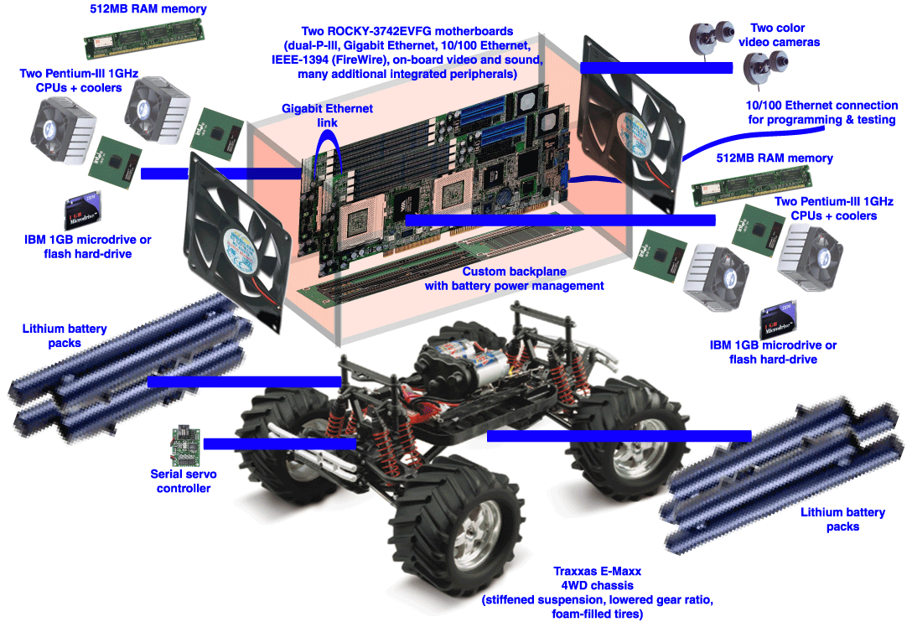
Beowulf + robot =
“Beobot”

Slide 36
A driving example: Beobots
Goal: build robots that can operate in unconstrained environments and that can solve a wide variety of tasks.
We have:
  Lots of CPU power
  Prototype robotics platform
  Visual system to find interesting objects in the world
  Visual system to recognize/identify some of these objects
  Visual system to know the type of scenery the robot is in
We need to:
  Build an internal representation of the world
  Understand what the user wants
  Act upon user requests / solve user problems

Slide 37
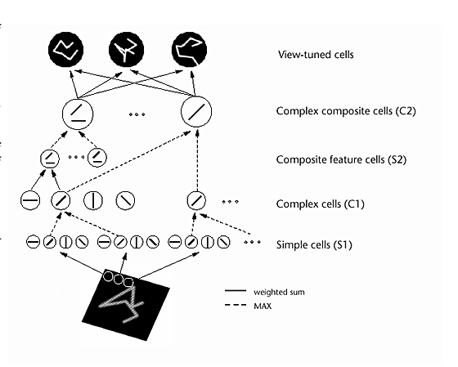
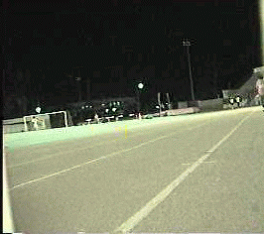
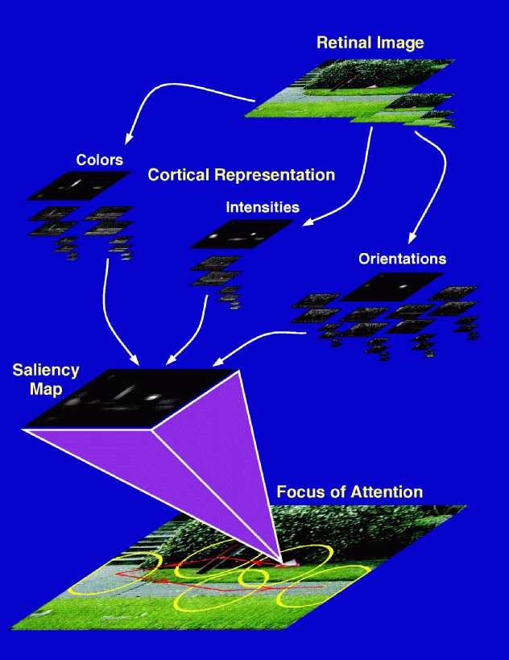
The basic components of vision
+
Original Downscaled Segmented
Scene Layout
& Gist
Riesenhuber & Poggio,
Nat Neurosci, 1999
Localized
Object
Recognition
Attention

Slide 38
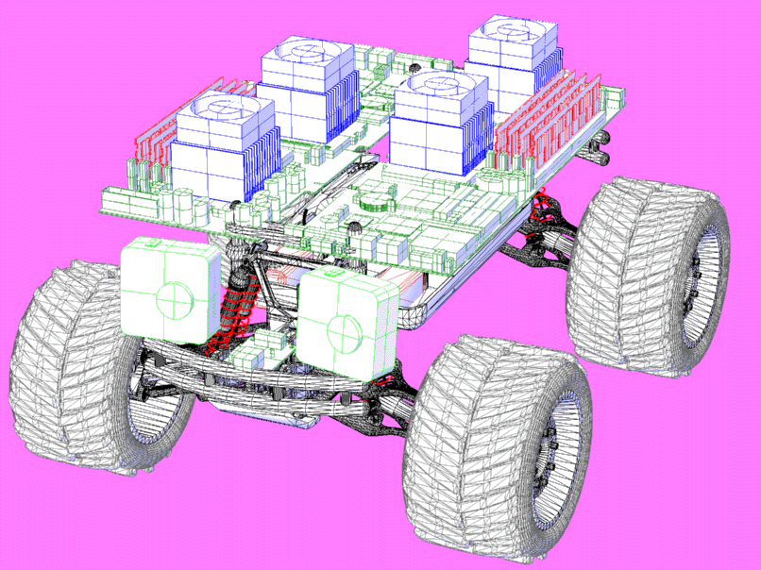

Slide 39
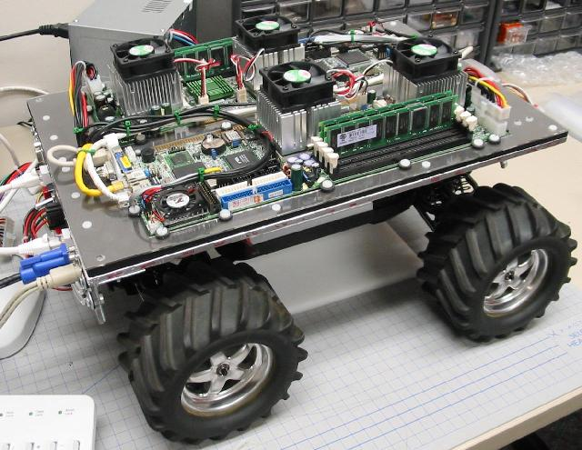
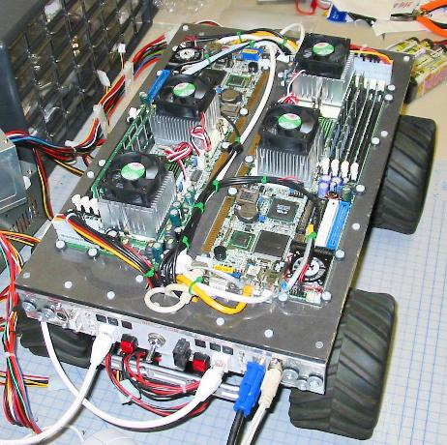
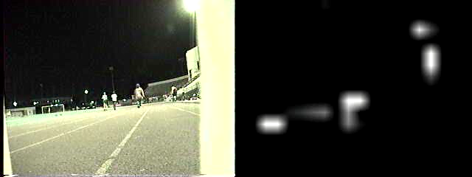
Beowulf + Robot =
“Beobot”

Slide 40

Main challenge: extract the “minimal subscene” (i.e., small
number of objects and actions) that is relevant to present
behavior from the noisy attentional scanpaths.
Achieve representation for it that is robust and stable against
noise, world motion, and egomotion.

Slide 41
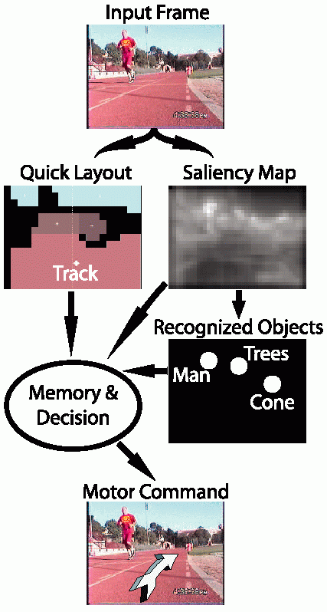
Prototype
Stripped-down version of proposed
general system, for simplified
goal: drive around USC olympic
track, avoiding obstacles
Operates at 30fps on quad-CPU
Beobot;
Layout & saliency very robust;
Object recognition often confused
by background clutter.

Slide 42
Major issues
How to represent knowledge about the world?
How to react to new perceived events?
How to integrate new percepts to past experience?
How to understand the user?
How to optimize balance between user goals & environment constraints?
How to use reasoning to decide on the best course of action?
How to communicate back with the user?
How to plan ahead?
How to learn from experience?

Slide 43
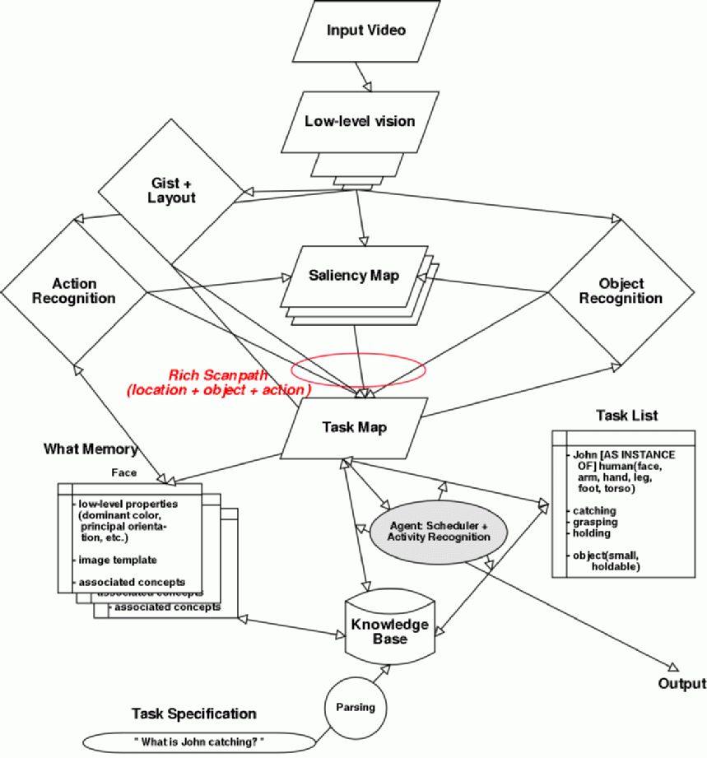
General architecture

Slide 44
Ontology
Khan & McLeod, 2000

Slide 45
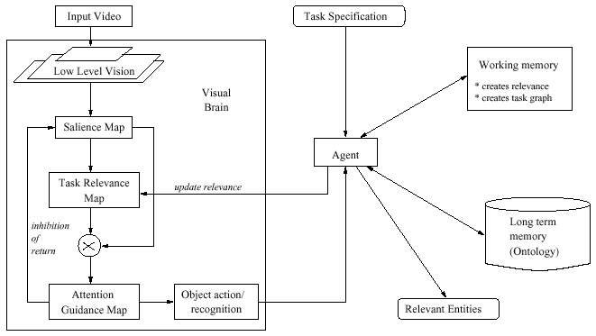
The task-relevance map
Scalar topographic map, with higher values at more relevant locations

Slide 46
More formally: how do we do it?
Use ontology to describe categories, objects and relationships:
Either with unary predicates, e.g., Human(John),
Or with reified categories, e.g., John ∈ Humans,
And with rules that express relationships or properties,
e.g., ∀x Human(x) ⇒ SinglePiece(x) ∧ Mobile(x) ∧ Deformable(x)
Use ontology to expand concepts to related concepts:
E.g., parsing question yields “LookFor(catching)”
Assume a category HandActions and a taxonomy defined by
catching ∈ HandActions, grasping ∈ HandActions, etc.
We can expand “LookFor(catching)” to looking for other actions in the category where catching belongs through a simple expansion rule:
∀a,b,c a ∈ c ∧ b ∈ c ∧ LookFor(a) ⇒ LookFor(b)

Slide 47
End of Lecture
AI is a very exciting area right now.
This course will teach you the foundations.
In addition, we will use the Beobot example to reflect on how this foundation could be put to work in a large-scale, real system.

